Slide 1
Verification and Validation of the General Mission Analysis Tool (GMAT)
Joel Parker
August 4, 2014
NASA Goddard Space Flight Center

Slide 2
Contents
Introduction to GMAT
Verification and Validation Overview
Numerical Results
Dynamics and Modeling
Finite Maneuvers
Mission Data Calculation Parameters
Sample Functional Testing Activities
GUI Testing
Conclusions

Slide 3
Contents
Introduction to GMAT
Verification and Validation Overview
Numerical Results
Dynamics and Modeling
Finite Maneuvers
Mission Data Calculation Parameters
Sample Functional Testing Activities
GUI Testing
Conclusions

Slide 4
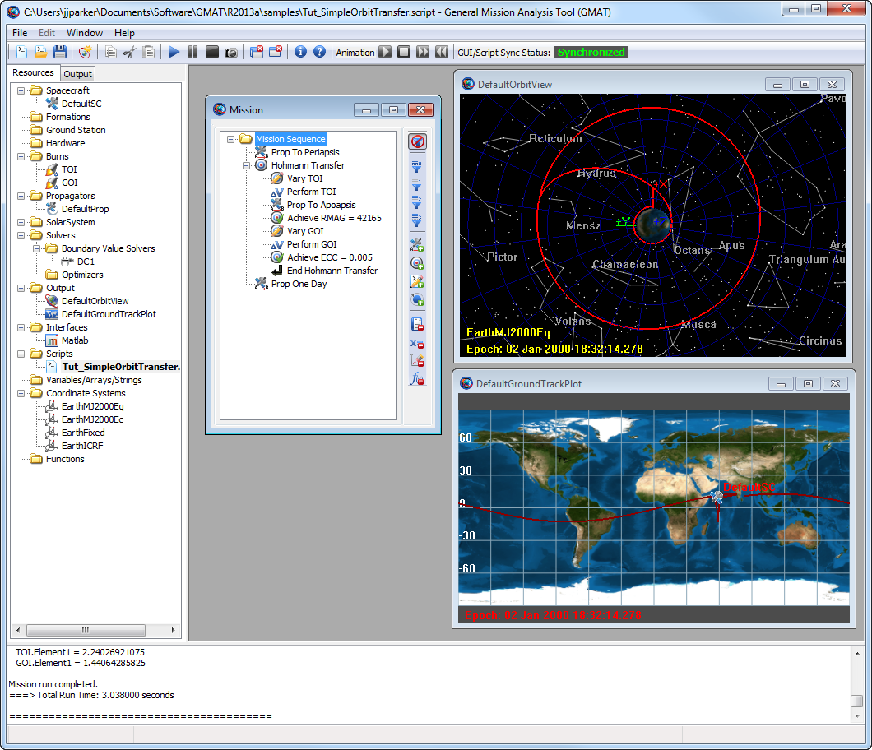
What is GMAT?
GMAT is a general mission design and analysis tool.
Key Applications:
Mission analysis/optimization
All orbital regimes
Key characteristics:
open source
high fidelity
feature rich
desktop oriented
Status: Fully tested and flight qualified

Slide 5
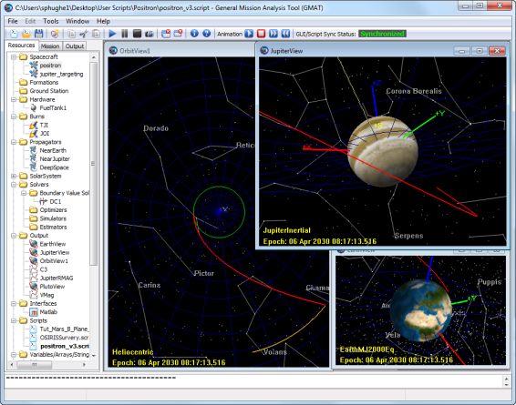
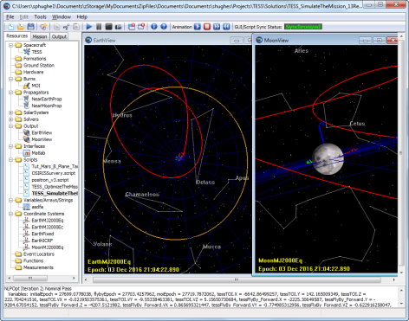
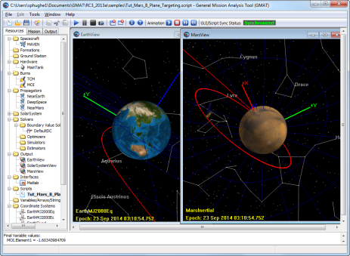
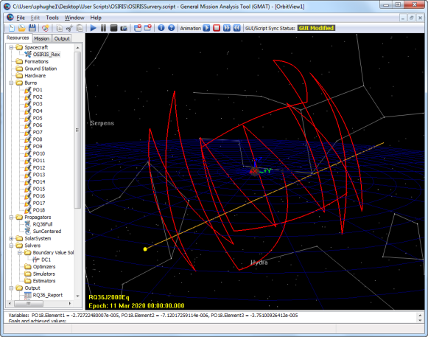
Customizable Tools to Go Anywhere
Customizable trajectory solutions to go anywhere
LEO
Libration points
Lunar
NEO
Interplanetary
End-to-End Support
Design the mission
Optimize the mission
Win the proposal
Fly the mission
Optimal Lunar Flyby
Outer Planet Transfers
Optimal Mars Trajectories
Download and find out more: gmatcentral.org
Asteroid (RQ36) Survey

Slide 6
Contents
Introduction to GMAT
Verification and Validation Overview
Numerical Results
Dynamics and Modeling
Finite Maneuvers
Mission Data Calculation Parameters
Sample Functional Testing Activities
GUI Testing
Conclusions

Slide 7
Project Context
2001: Requirements gathering
2002: Architectural design
2003: Implementation of system core
…feature development…
2010: Decision to prepare for operational use
…feature development…
2012–2013: V&V effort
Apr. 2013: First production release (R2013a)
Aug. 2013: Operationally certified (R2013b)

Slide 8
Goals of the V&V Effort
Technical Goals
Systematically evaluate and validate all models, components, and functionality
Fix all critical system defects
Update working specifications that define system behavior
Provide high quality end user documentation and training material
Prepare for system maintenance and further development of a Class B flight qualified system
Strategic goals
Position GMAT for larger community adoption
Position GMAT for flight qualification to begin in the spring of 2013.

Slide 9
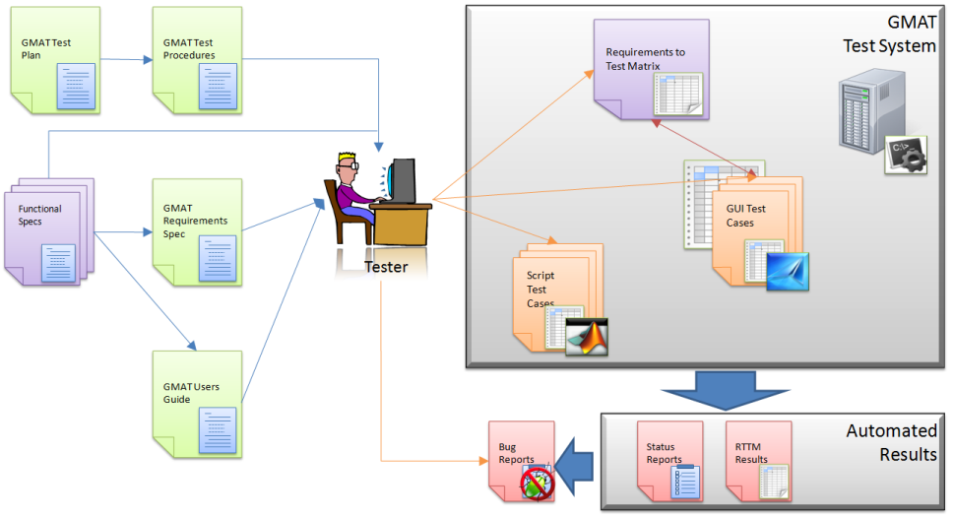
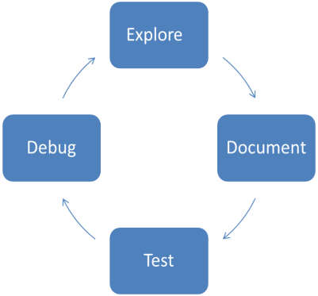
V&V Philosophy and Environment
Our V&V Philosophy
Test Summary
Produced about 13000 script tests
Produced about 3500 GUI tests
Regression Testing
Script tests run nightly for regression
GUI tests run weekly
Our Test Environment

Slide 10
Component Breakdown
GMAT contains many components
~30 resources (objects)
~25 commands
System-level components
We divided the testing effort into logical “component areas”
Then, we performed V&V for each component area as a unit
Component Area | Description/Features
Dynamics/Models | Numerical models for orbit and attitude propagation, solar system and coordinate system models including spacecraft orbit state representations, spacecraft ballistic and mass properties, etc.
Powered Flight | Impulsive and finite maneuvering including tanks, thrusters, impulsive maneuver, finite maneuver
Solver Infrastructure | Algorithms and infrastructure for solving boundary value and optimization problems.
Programming Infrastructure | Algorithms and features for customization including custom scripting, user defined variables and arrays, scripted custom equations, built-in astrodynamic computations, control flow, and external interfaces.
Output\Utils | Components to support graphical and data output such as xy-plots, 3-D graphics, report files, and ephemeris files.
Application Control | Inherently interface elements such as file menus, command line interfaces, and the script editor.
We tested components in logical groups.

Slide 11
Test Types
A particular feature can be tested in several ways
Does it operate correctly on nominal input?
Does it respond appropriately on invalid input?
Does it work as a part of the whole system?
We defined 6 test types and applied them to each feature.
Test Type | Description
Numeric | Tests of physical and mathematical models. Numeric tests are performed by comparing output to external "truth".
Functional | Tests that verify non-numeric functionality, such as plotting styles, file formats, and control flow behavior.
Input validation | Tests that ensure user inputs are validated by the system and the correct error messages are provided for invalid user input.
End-to-end | Tests that solve an end-to-end engineering problem such as a lunar transfer or orbital maneuver. These tests are "fit for use" tests and are applications of GMAT to real-world problems.
Stress | Test designed to stress the system and make heavy use of system resources.
Edge/Corner | Tests designed to test models at the boundaries of applicability, in the GMAT context this often means testing models near numerical singularities.
We performed standard test types.

Slide 12
Contents
Introduction to GMAT
Verification and Validation Overview
Numerical Results
Dynamics and Modeling
Finite Maneuvers
Mission Data Calculation Parameters
Sample Functional Testing Activities
GUI Testing
Conclusions

Slide 13
Dynamics and Modeling
Dynamics and modeling are core to GMAT.
Component area consists of:
Orbit epoch/state representations
Spacecraft mass properties
Attitude representations
Solar system models
Numerical integrators
Force modeling
Coordinate systems
All went through the full V&V cycle.
Here, we show results for force modeling, integrators, coordinate systems only.
See the paper for details on the others.

Slide 14
Orbit Propagation Comparison: Individual Force Modeling
 | Dynamics Model
Orbital Regime | Spherical Gravity | Harmonic gravity | Tides | Point mass perturbation | SRP | MSISE90 | NRLMSISE00 | Jacchia-Roberts | Relativistic Correction
ISS | 7.1E-06 | 2.5E-03 | 3.3E-01 | 1.5E-05 | 1.3E-01 | 1.8E-01 | 1.1E+00 | 1.9E+00 | 3.8E-02
Sun Sync | 3.9E-05 | 5.0E-04 | 5.7E-01 | 3.6E-05 | 1.7E-01 | 1.8E-02 | 5.8E+00 | 2.0E+00 | x
GPS | 2.7E-06 | 1.5E-04 | 2.5E-02 | 2.3E-05 | 4.7E-02 | 1.4E-05 | 4.2E-06 | 2.7E-06 | x
GEO | 6.3E-06 | 2.8E-05 | 5.0E-02 | 1.8E-04 | 2.4E-05 | 6.3E-06 | 5.2E-05 | 6.3E-06 | 2.3E-03
Molniya | 2.4E-04 | 6.1E-03 | 6.0E+00 | 2.0E-04 | 5.8E-01 | 1.8E-03 | 4.3E+00 | 1.3E-01 | x
Luna | 7.3E-05 | 1.9E-04 | N/A | 2.2E-04 | 1.1E-04 | N/A | N/A | N/A | x
Venus | 9.0E-03 | 1.1E-02 | N/A | 1.4E-02 | 3.7E-02 | N/A | N/A | N/A | x
Mars | 6.1E-02 | 1.2E-01 | N/A | 3.2E-01 | 6.0E-01 | N/A | N/A | N/A | x
Difference between GMAT and reference system for each force model individually
RSS position errors after propagation duration (m)
Most cases show mm- to cm-level agreement.
See paper for initial state vectors, durations, etc.
Velocity errors consistently 2–4 orders of magnitude lower

Slide 15
Orbit Propagation Comparison: Combined Force Modeling
Test Case | Max Position Diff. RSS (m)
GEO (TBPM,HG,Drag,SRP,Tide) | 9.2227E-01
GEO (TBPM,HG,Drag,SRP) | 1.7184E-04
GPS (TBPM,HG,Drag,SRP,Tide) | 5.2289E-01
GPS (TBPM,HG,Drag,SRP) | 7.5020E-02
ISS (TBPM,HG,Drag,SRP,Tide) | 1.9932E+00
ISS (TBPM,HG,Drag,SRP) | 1.6639E+00
Molniya (TBPM,HG,Drag,SRP) | 5.1301E-01
SunSync (TBPM,HG,Drag,SRP) | 3.3214E-01
Lunar Transfer (TBPM, HG, SRP) | 8.6480E-01
Mars Transfer (TBPM, HG, SRP) | 5.2626E+00
Asteroid (TBPM, HG, SRP) | 4.6731E-03
Earth Moon L2 (TBPM, SRP) | 8.0749E-01
Deep Space (TBPM, Rel) | 3.8275E-02
Titan(TBPM, SRP) | 2.5002E-01
Worst-case (bounding) comparisons between STK and other tools
Data from Vallado¹, with GMAT added
GMAT shows comparable or better worst-case results.
Software | Harm. Gravity | Point Mass | SRP | Drag
GTDS | 0.07 | 0.06 | 2.50 | 575.00
TRACE | 0.0020 | 0.02 | 1.50 | 750.00
Special K | N/A | 0.07 | N/A | N/A
GMAT | 0.01 | 0.0002 | 0.58 | 5.77
GEODYN | N/A | N/A | N/A | 1000
GMAT compares very well against industry-standard tools.
Meter-level or better agreement
for full force modeling.
¹Vallado, David, A. “An Analysis of State Vector Propagation Using Differing Flight Dynamics Programs”, AAS/AIAA Space Flight Mechanics Conference, 2005.

Slide 16
Numerical Integrators
Orbit | Data | RKV89 | RKN68 | RK56 | PD45 | PD78 | ABM
ISS | Run Time | 1.53 | 1.00 | 2.14 | 2.78 | 1.46 | 3.41
 | Error (m) | 0.003 | 64.060 | 0.022 | 0.002 | 0.006 | 0.012
Molniya | Run Time | 1.32 | 1.47 | 1.99 | 3.08 | 1.00 | 3.35
 | Error (m) | 0.007 | 0.601 | 0.059 | 0.032 | 0.043 | 380.125
Lunar Flyby | Run Time | 1.00 | 1.01 | 2.26 | 2.98 | 2.21 | 3.30
 | Error (m) | 0.063 | 0.017 | 0.002 | 0.023 | 0.000 | 0.236
Mars Transfer | Run Time | 1.02 | 1.04 | 1.14 | 1.40 | 1.00 | 3.07
 | Error (m) | 0.030 | 0.001 | 0.043 | 0.194 | 0.009 | 25.231
Finite burn 1 | Run Time | 1.27 | N/A | 1.24 | 1.26 | 1.00 | 1.45
 | Error (m) | 0.002 | N/A | 0.006 | 0.002 | 0.002 | 0.000
Finite burn 2 | Run Time | 1.03 | N/A | 1.18 | 1.31 | 1.00 | 1.54
 | Error (m) | 0.002 | N/A | 0.000 | 0.000 | 0.001 | 0.003
Integrators tested via “closure” tests
Propagate forward, then backward
Compare initial and final states
Test performed with and without finite burn
Results shown for both error and performance
Performance results normalized: 1.0 is best-performing result
All integrators were validated. Prince-Dormand 7(8) is the best general-purpose integrator available.

Slide 17
Coordinate Systems
GMAT contains 19 coordinate system types
Conversions from/to each were tested
Shown: Conversion from FK5 (internal system)
Conversion using circular LEO state vector, SMA = 6800 km
Order-of-magnitude results:
RSS position: order of mm or better
RSS velocity: order of μm/s or better
Angular: order of 10⁻⁸° or better
Conversion Type (FK5 to…) | Position Comparison |  | Velocity Comparison
 | RSS Diff (m) | Angle Diff (deg) | RSS Diff (m/s) | Angle Diff (deg)
BodyFixed | 5.79E-03 | 4.88E-08 | 5.65E-06 | 4.23E-08
BodySpinSun | 2.17E-04 | 1.83E-09 | 1.35E-07 | 1.01E-09
GSE | 1.11E-05 | 9.36E-11 | 1.22E-08 | 9.14E-11
GSM | 2.13E-04 | 1.79E-09 | 3.66E-06 | 2.74E-08
ICRF | 7.80E-03 | 6.57E-08 | 1.97E-06 | 1.47E-08
MJ2000Ec | 9.19E-05 | 7.74E-10 | 1.05E-07 | 7.84E-10
MJ2000Eq | 0.00E+00 | 0.00E+00 | 6.39E-12 | 4.78E-14
MODEc | 3.33E-07 | 2.80E-12 | 2.31E-11 | 1.73E-13
MODEq | 9.37E-10 | 7.90E-15 | 6.53E-12 | 4.89E-14
MOEEc | 6.75E-09 | 5.69E-14 | 5.42E-12 | 4.06E-14
MOEEq | 4.90E-09 | 4.13E-14 | 6.14E-12 | 4.59E-14
ObjectReferenced | 1.11E-05 | 9.36E-11 | 1.22E-08 | 9.14E-11
TODEc | 2.00E-04 | 1.69E-09 | 2.20E-07 | 1.65E-09
TODEq | 1.98E-04 | 1.67E-09 | 2.38E-07 | 1.78E-09
TOEEc | 6.55E-05 | 5.52E-10 | 7.20E-08 | 5.39E-10
TOEEq | 2.05E-04 | 1.72E-09 | 2.57E-07 | 1.92E-09
Topocentric | 5.92E-03 | 4.99E-08 | 5.68E-06 | 4.25E-08
Excellent agreement for all transformations

Slide 18
Finite Maneuvers
Test Category | Position RSS Error (m) |  | Velocity RSS Error (m/s) |  | Mass Error (g)
 | Low | High | Low | High | Low | High
Orbit | 1.1e-3 | 5.0e-2 | 6.4e-7 | 7.7e-4 | 3.4e-6 | 1.1e-4
Thruster Configuration | 3.0e-4 | 5.0e-3 | 3.8e-7 | 6.4e-6 | 2.7e-8 | 2.4e-5
Coordinate System | 2.3e-3 | 4.3e-3 | 2.2e-6 | 4.5e-6 | 1.5e-5 | 3.0e-5
Tank Configuration | 2.4e-4 | 9.7e-2 | 2.3e-7 | 7.7e-5 | 3.5e-7 | 4.8e-3
All | 2.4e-4 | 5.0e-2 | 2.3e-7 | 7.7e-4 | 2.7e-8 | 4.8e-3
Finite maneuvers tested from a baseline configuration, with variations in:
Orbit type (central body)
Thruster configuration (thrust vector, mass depletion, Isp, etc.)
Coordinate system (VNB, LVLH, inertial, etc.)
Tank configuration (mass, pressure, temp., pressure model, etc.)
Over 900 cases performed
Each propagated 120 minutes with finite maneuver turned on
Truth data compared to Matlab, FreeFlyer
RSS position error cm-level or better, mass error mg-level or better

Slide 19
Mission Data Calculation Parameters
Orbit | Body | Alt. | Beta angle | Orbit energy | Mean motion | Ang. mom. | Vel. at periapsis
GEO | Earth | 5e-12 | < 1e-16 |  | 5e-14 | 8e-12 | 2e-11
 | Venus | 2e-12 | 2e-12 | 8e-11 | 6e-14 | 2e-11 | 4e-11
Hyperbolic | Earth | 3e-9 | 7e-15 | 6e-8 | 2e-11 | 2e-7 | 9e-8
 | Venus | 2e-11 | 3e-14 | 3e-8 | 1e-8 | 2e-8 | 2e-8
Mars | Earth | 2e-12 | < 1e-16 | 3e-9 | 4e-9 | 2e-9 | 2e-9
 | Mars | 4e-8 | < 1e-16 | 2e-9 | 2e-12 | 5e-10 | 5e-10
Luna | Earth | 2e-11 | < 1e-16 | 5e-8 | 3e-14 | 9e-9 | 9e-9
 | Luna | 3e-9 | < 1e-16 | 7e-10 | 6e-13 | 4e-10 | 4e-10
Parameter calculations tested for multiple orbit types, with multiple dependencies
Results compared against STK/Astrogator, custom STK/Astrogator scripting, and custom GMAT scripting
Selection of results shown
Results are percent difference between GMAT and truth solution
1 = 100% error
1e-12 = 11 digits of agreement
Excellent agreement for all calculations

Slide 20
Contents
Introduction to GMAT
Verification and Validation Overview
Numerical Results
Dynamics and Modeling
Finite Maneuvers
Mission Data Calculation Parameters
Sample Functional Testing Activities
GUI Testing
Conclusions

Slide 21
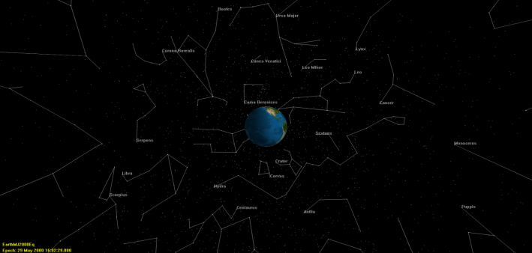
3-D Graphics
V&V testing for Orbit View:
Preliminary testing involved visual inspection of all 3-D graphics behavior
Key elements of GMAT’s graphics were compared against STK and Celestia benchmarks
GMAT & STK Comparison showing spacecraft trajectory,
ecliptic plane, xy plane and sun-centered MJ2000Eq coordinate sys.
GMAT & Celestia showing star constellations comparison

Slide 22
Mathematical Expressions
Same syntax as MATLAB expressions
Wrote random generator to generate thousands of valid expressions
Results validated against MATLAB
100 scripts w/ random contents in regression system
Operators | Functions
+ (addition) | sin
- (subtraction) | cos
* (multiplication) | tan
/ (division) | asin
' (transpose) | acos
^ (power) | atan
 | atan2
 | log
 | log10
Example operators and functions

Slide 23
Contents
Introduction to GMAT
Verification and Validation Overview
Numerical Results
Dynamics and Modeling
Finite Maneuvers
Mission Data Calculation Parameters
Sample Functional Testing Activities
GUI Testing
Conclusions

Slide 24
GUI System Tests and “Unit” Tests
Unit tests ensure verification and acceptance testing of every button, menu, text box, etc.
One unit test project <-> one object (resource, command, script window, mission sequence, etc)
System tests validates the GMAT GUI by testing the entire application
End-to-end test cases
Simulating typical end-user interactions
Tests are implemented using SmartBear’s TestComplete GUI testing tool
Test Report History

Slide 25
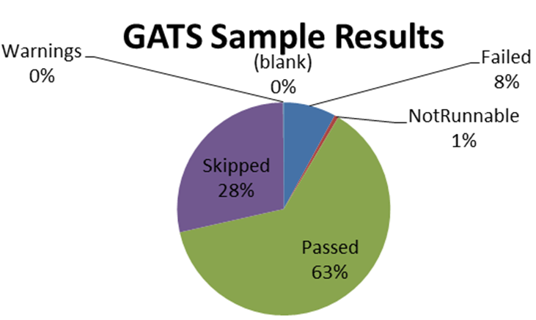
GATS and Requirements To Test Matrix
GMAT Automated Test Suite (GATS) tool executes RTTM
Automate the execution of the GUI tests
Map tests to requirements
Report results
~3400 tests executed in 4 days (biweekly)
Smaller subset executed nightly

Slide 26
Contents
Introduction to GMAT
Verification and Validation Overview
Numerical Results
Dynamics and Modeling
Finite Maneuvers
Mission Data Calculation Parameters
Sample Functional Testing Activities
GUI Testing
Conclusions

Slide 27
Conclusions
Accomplished technical and strategic goals.
Systematically evaluated and validated all models, components, and functionality
Fixed nearly all critical system defects
Updated working specifications that define system behavior
Provided high quality end user documentation and training material
Prepared for system maintenance and further development of a NASA Class B flight qualified system
Positioned GMAT for larger community adoption
Positioned GMAT for flight qualification
Successful system-wide V&V effort led to release of GMAT R2013a, its first production-quality release.
Enabled a successful follow-on flight qualification effort.

Slide 28
Backup

Slide 29
Test Types
Test Type | Description
Numeric Tests | Tests of physical and mathematical models. Numeric tests are performed by comparing output to external "truth".
Functional tests | Tests that verify non-numeric functionality, such as plotting styles, file formats, and control flow behavior.
Input validation | Tests that ensure user inputs are validated by the system and the correct error messages are provided for invalid user input.
End-to-end tests | Tests that solve an end-to-end engineering problem such as a lunar transfer or orbital maneuver. These tests are "fit for use" tests and are applications of GMAT to real-world problems
Stress Tests | Test designed to stress the system and make heavy use of system resources.
Edge corner tests | Tests designed to test models at the boundaries of applicability, in the GMAT context this often means testing models near numerical singularities.
Test Type | Description
Numeric Tests | Tests of physical and mathematical models. Numeric tests are performed by comparing output to external "truth".
Functional tests | Tests that verify non-numeric functionality, such as plotting styles, file formats, and control flow behavior.
Input validation | Tests that ensure user inputs are validated by the system and the correct error messages are provided for invalid user input.
End-to-end tests | Tests that solve an end-to-end engineering problem such as a lunar transfer or orbital maneuver. These tests are "fit for use" tests and are applications of GMAT to real-world problems
Stress Tests | Test designed to stress the system and make heavy use of system resources.
Edge corner tests | Tests designed to test models at the boundaries of applicability, in the GMAT context this often means testing models near numerical singularities.
We performed standard test types.

Slide 30
Powered Flight

Slide 31
Example Tank Configuration
Tank | Description | Mass (kg) | Pressure (kPa) | Temp (C) | Ref Temp (C) | Volume (m³) | Fuel Density (kg/m³) | Pressure Model
A | Baseline | 725 | 1200 | 20 | 12 | 0.8 | 1029 | PR
B | High Mass | 820 | 1200 | 20 | 12 | 0.8 | 1029 | PR
C | High Pressure | 725 | 2500 | 20 | 12 | 0.8 | 1029 | PR
D | Low Pressure | 725 | 725 | 20 | 12 | 0.8 | 1029 | PR
E | High Temp | 725 | 1200 | 200 | 12 | 0.8 | 1029 | PR
F | Low Temp | 725 | 1200 | 2 | 12 | 0.8 | 1029 | PR
G | High Ref Temp | 725 | 1200 | 20 | 100 | 0.8 | 1029 | PR
H | Low Ref Temp | 725 | 1200 | 20 | 2 | 0.8 | 1029 | PR
T | High Volume | 725 | 1200 | 20 | 12 | 80 | 1029 | BD
U | Low Density | 725 | 1200 | 20 | 12 | 8.0 | 101.325 | BD
V | High Density | 725 | 1200 | 20 | 12 | 0.8 | 2500 | BD

Slide 32
Example Thruster Configurations
Coordinate System | Designation | Description
MJ2000Eq | CS0 | J2000-based Earth-centered Earth mean equator inertial
Earth VNB | CS1 | Earth Velocity-Normal-Binormal (VNB) is a non-inertial coordinate system based upon the motion of the spacecraft with respect to the Earth. The X-axis of this coordinate system is along the velocity of the spacecraft with respect to the Earth, the Y-axis is along the instantaneous orbit normal (with respect to the Earth) of the spacecraft, and the Z-axis completes the right-handed set.
Earth LVLH | CS2 | Earth Local Vertical Local Horizontal (LVLH) is a non-inertial coordinate system based upon the motion of the spacecraft with respect to the Earth. The X-axis of this coordinate system is the position of the spacecraft with respect to the Earth, the Z-axis is the instantaneous orbit normal (with respect to the Earth) of the spacecraft, and the Y-axis completes the right-handed set.
SpacecraftBody | CS3 | SpacecraftBody is the attitude system of the spacecraft. Since the thrust is applied in this system, GMAT uses the attitude of the spacecraft, a spacecraft attribute, to determine the inertial thrust direction.
Custom Designed Earth VNB | CS4 | Same coordinate system as Earth VNB. (created using a different user interface)

Slide 33
Summary of Impulsive Maneuver Results
Orbit | Position RSS Error (m) | Velocity RSS Error (m/s) | Mass Error (g)
Earth | 0 | 0 | 2.27374E-10
Moon | 2.59206E-08 | 0 | 2.27374E-10
Mars | 5.96083E-06 | 1.7764E-12 | 2.27374E-10
Coordinate System | Position RSS Error (m) | Velocity RSS Error (m/s) | Mass Error (g)
Earth Mean Equator J2000 (CS0) | 0 | 0 | 2.27374E-10
Earth VNB (CS1) | 0 | 0 | 2.27374E-10
Earth LVLH (CS2) | 0 | 0 | 2.27374E-10
SpacecraftBody (CS3) | 0 | 0 | 2.27374E-10
Custom Designed Earth VNB (CS4) | 0 | 0 | 2.27374E-10
Test Category | Position RSS Error (m) |  | Velocity RSS Error (m/s) |  | Mass Error (g)
 | Low | High | Low | High | Low | High
Orbit | 0 | 6.0e-6 | 0 | 1.8e-12 | 2.3e-10 | 2.3e-10
Maneuver Coordinate System | 0 | 0 | 0 | 0 | 2.3e-10 | 2.3e-10
Tank Configuration | 0 | 0 | 0 | 0 | 0 | 2.3e-10
All | 0 | 6.0e-6 | 0 | 1.8e-12 | 0 | 2.3e-10

Slide 34
Mission Data Parameters
Parameters are calculated on request
Can be read-only or read-write
One of three types:
Standalone
Central-body dependency
Coordinate system dependency
Truth sources:
STK
custom MATLAB
custom GMAT scripting
Parameter | Access | Dependency
Spacecraft
Cartesian position | RW | Coordinate system
Keplerian elements | RW | Coordinate system, celestial body
Epoch | RW | (None)
Attitude quaternion | RW | (None)
Duty cycle | RW | (None)
Thrust scale factor
Fuel tank
Fuel mass | RW | (None)
Fuel density
Impulsive maneuver
Cartesian maneuver direction | RW | (None)
Example parameters

Slide 35
Results: Coordinate-System Parameters
Orbit | Coordinate system | Velocity magnitude | RAAN | Declination | Right ascension of velocity
GEO | Earth J2000 | 4e-12 | 5e-14 | 5e-14 | 2e-9
 | Saturn Fixed | 8e-12 | 2e-5 | 8e-13 | 2e-5
Hyperbolic | Earth J2000 | 3e-8 | 1e-13 | 4e-9 | 4e-9
 | Saturn Fixed | 6e-13 | 2e-6 | 7e-13 | 2e-5
Mars | Mars J2000 | 5e-9 | 2e-11 | 2e-5 | 9e-7
 | Saturn Fixed | 6e-13 | 6e-6 | 3e-13 | 6e-6
Luna | Moon J2000 | 5e-10 | 6e-13 | 2e-6 | 3e-7
 | Saturn Fixed | 4e-13 | 3e-6 | 4e-13 | 2e-5
Parameter calculations tested for multiple orbit types, with multiple coordinate-system dependencies
Results compared against STK/Astrogator
Selection of results shown
Results are percent difference between GMAT and truth solution
1 = 100% error
1e-12 = 11 digits of agreement

Slide 36
Output/Utilities Methodology and Results
Extensive & Systematic testing of all components in Output/Utilities feature area was done:
OrbitView
Spacecraft Visualization
GroundTrackPlot
XYPlot
ReportFile
EphemerisFile
Report
Toggle On/Off
ClearPlot
MarkPoint
PenUp & PenDown
Only test results for 2-D, 3-D graphics and Ephemeris File are presented

Slide 37
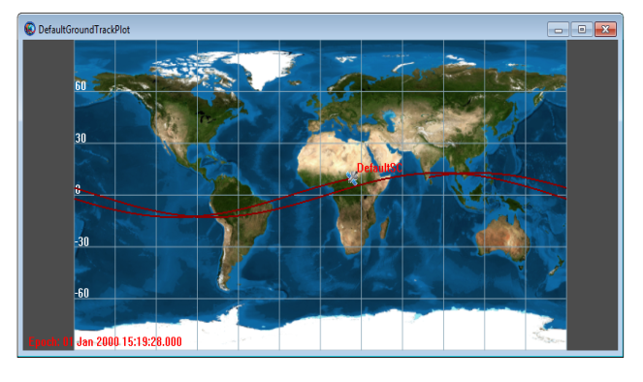
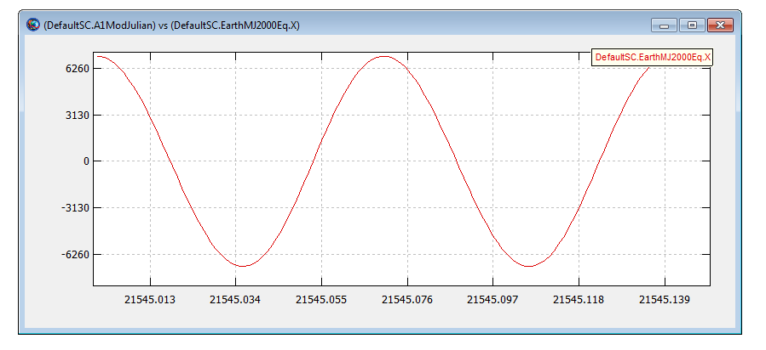
2-D Graphics: Ground Track & XY Plot
V&V testing methodology for Ground Track Plot employed standard GMAT GUI testing plans/procedures:
Testing involved visual inspection of each functional element
Compared graphical output to expected results from external tools
Prepared data for automated GUI regression tests that are run
using the GUI regression test environment
V&V testing methodology for XY Plot:
Initial testing involved visual inspection of all XY plot functional elements
Compared XY Plot output with MATLAB as the external benchmark tool
Equivalent XY data plots generated in MATLAB and GMAT and overlaid
plots for visual comparison
For more rigorous & automated GUI testing, test scripts were
written to test each XY plot element. Test scripts are used by
the GUI regression test environment

Slide 38
Ephemeris File
V&V testing methodology for EphemerisFile:
Extensive automated testing of ephemeris file component was conducted through GMAT’s script test system
Test scripts for all functional elements were written
For CCSDS ephemeris format, we compared interpolation to MATLAB and STK implementations
For SPK ephemeris format, we tested SPK ephemeris output comparing the results to STK and MICE toolbox

Slide 39
Programming Infrastructure
Two testing areas
Script Language: functional testing
Variables, arrays
Assignment, mathematics
Control flow, logical operators
External interfaces
Mission Data Parameters: numeric testing

Slide 40
Script Language
All features were tested with all applicable input and output types:
literals: numeric, strings
resources: variables, arrays, array elements, string variables, calculated parameters
mathematical expressions
Special testing for:
Logical operators: all data types w/ all operators
MATLAB interface: all data types as input/output
Mathematical expressions

Slide 41

GMAT Test Processes

Slide 42
Goals of GUI Testing
Reasonable confidence that GMAT is user-ready
100% coverage of GUI – every widget in the GUI gets exercised at least once
100% requirements fulfillment – every GUI-related requirement is fulfilled by the GUI
Repeatable
Maintainable

